Slide 1


Studies on Human Behaviour Methods and tools for data collection. Passive data: smartphones or other devices.
Mattia Zeni
University of Trento

Slide 2
Outline
Study human behaviour (15min)
Types of data for studying human behaviour (15min)
Which types of sensor data? (15min)
Where to collect data from? (15min)
Laboratory setting vs in the wild concept (15min)
The i-Log application (15min)

Slide 3
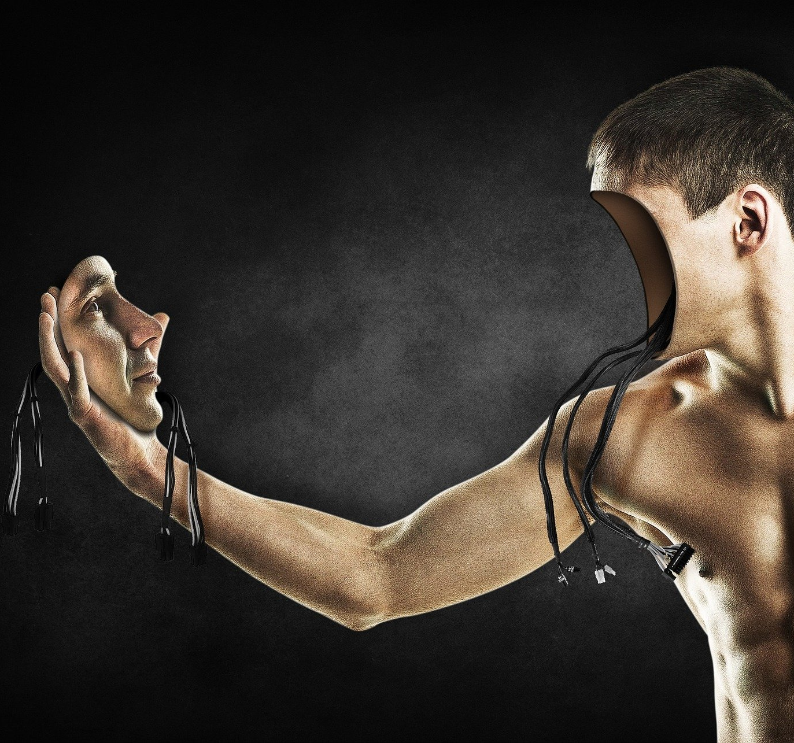
Study human behaviour

Slide 4
Objective – What do we want to achieve?
We want to study human behavior.
Let’s split this sentence into smaller elements. The goal it to arrive to a list of actionable items
Actionable = has value and leads to a result when it’s done
What is human behaviour?
What is the purpose of the study?
What is the scope? Which humans? What part of the behaviour?

Slide 5
What is human behaviour?
Human behaviour refers to the way humans act and interact. It is based on and influenced by several factors, such as genetic make-up, culture and individual values and attitudes.
Nature.com
People are very complex systems.
We act based on our needs, habits and routines.
Consequently, everyone acts differently.

Slide 6
What is human behaviour?
If you think about it, most of our actions can be described by four main components:
Activity (what)
Location (where)
Interactions with others (with whom)
Interactions with other objects (with what)
The same activity (going to work) has different instantiations for every one of us, considering those four elements. This is the contextual part.
Context is:
“…a theory of the world which encodes an individual’s subjective perspective about it…”
[Giunchiglia, 1993]. “Contextual reasoning”. In: Epistemologia, special issue on I Linguaggi e le Macchine 16, pp. 345–364

Slide 7
What is human behaviour?
We now have a characterization of human behaviour that can be measured, through it’s four components: activity, location, social, objects.
You can see that now it’s incredibly easier than before (but still absolutely hard) thinking about studying human behaviour.
The simplest solution would be to manually annotate those four dimensions.

Slide 8
What is the purpose of the study?
Why we want to study and understand how people act and interact?
What is the role of AI in all this? Automatize the process.
Because we want to understand
Because we want to nudge
Because we want to control
Because we want to support
Because we want to empower

Slide 9
What is the purpose of the study?
AI empowering humans

Slide 10
What is the scope?
OPEN WORLD, IN THE WILD

Slide 11
Motivating example
The user
What?
Where?
With whom?
The core is always the user, and by chance his name is Fausto
He has an appointment for lunch
The restaurant is in the city center
The lunch is with an old friend

Slide 12
What is the role of technology?
Event in the Agenda
Manual Configuration
Smartphone
Notifications
Empower users with applications
The user can add the event in the Agenda
Alert me 30 minutes before the event
A notification will popup to alert the user

Slide 13
Motivating example (part 2)
External factors
Unexpected events
Personality traits
Personal goals
Adaptation to weather conditions
Adaptation to unexpected events
Fausto is always late
Personal goal of doing more than 10000 steps per day

Slide 14
What should the role of technology be?
User state of affairs
Adaptation and personalization
Personalized services
Smartphone
Empower users with applications
The machine should be aware of the user situation
The machine should adapt to this state of affairs and react accordingly
The machine helps the human through useful service

Slide 15
Summary - Study human behavior
What is human behaviour?
What is the purpose of the study?
What is the scope? Which humans? What part of the behaviour?
We want to understand how people act and interact in four dimensions: activities, locations, people and objects.
The final goal is to empower humans
We want to do so in the wild (open world), with the final users

Slide 16

Types of data for studying human behaviour

Slide 17
What do we want to achieve?
Time diaries
Video streams
Sensor streams
Health records

Slide 18

Where to collect data from?

Slide 19
Which devices can generate sensor data?

Slide 20
Sensor data about human behaviour
Sensor data is the output of a device that detects and responds to some type of input from the physical environment. The output may be used to provide information or input to another system or to guide a process.

Slide 21
Objective – Examples of sensor data

Slide 22
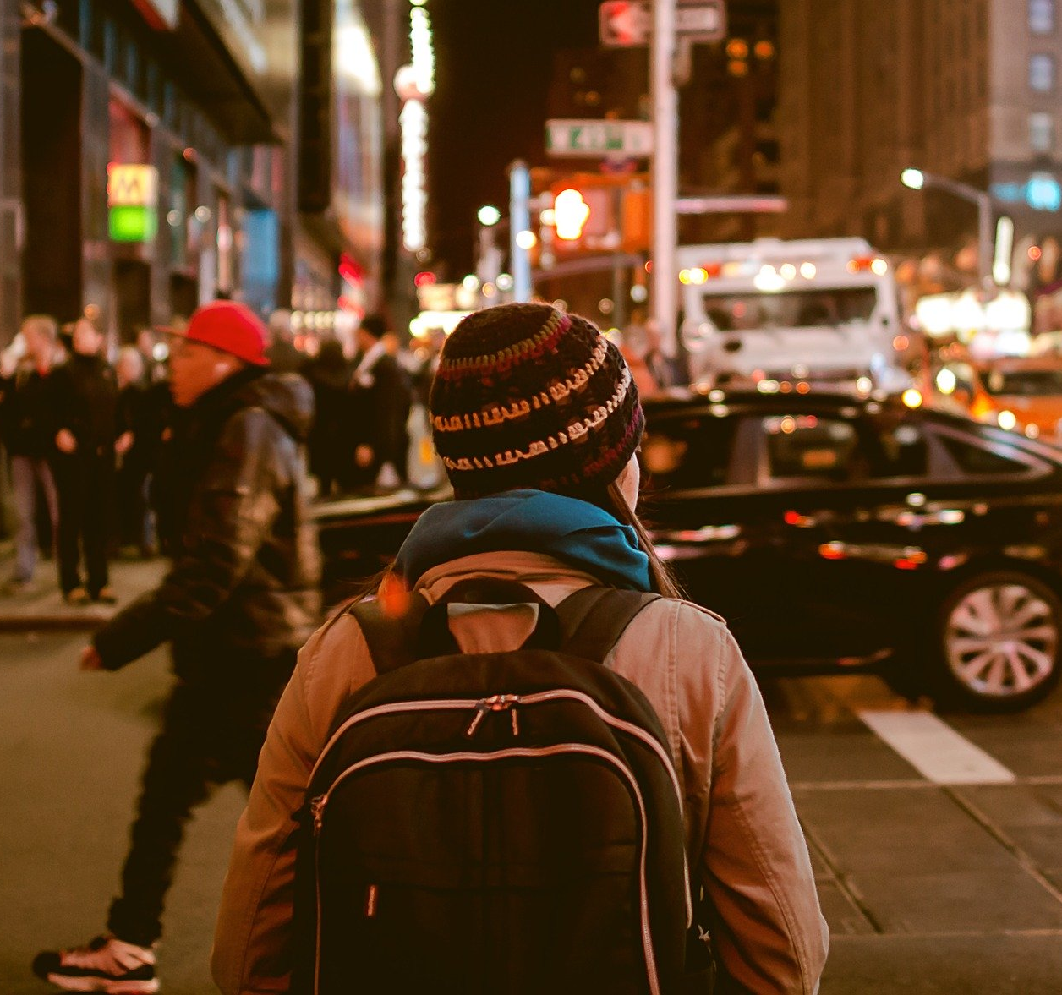
Laboratory setting or in the wild

Slide 23
Objective – Examples of sensor data

Slide 24
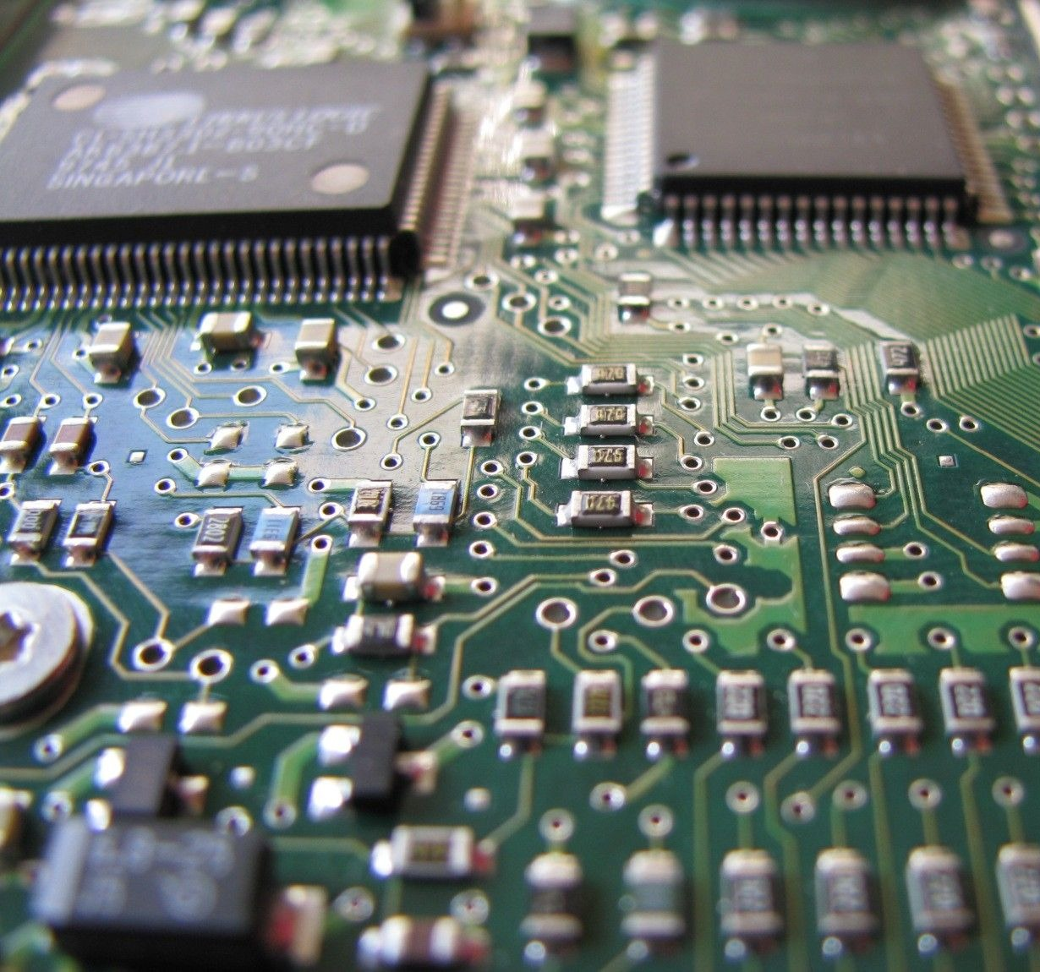
Which types of sensor data

Slide 25
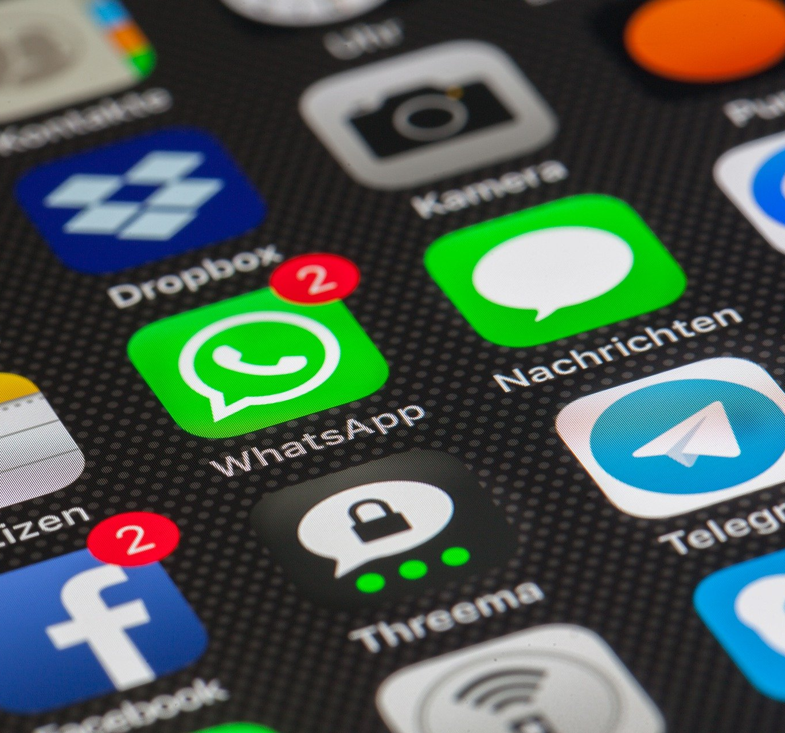
The i-Log application

Slide 26
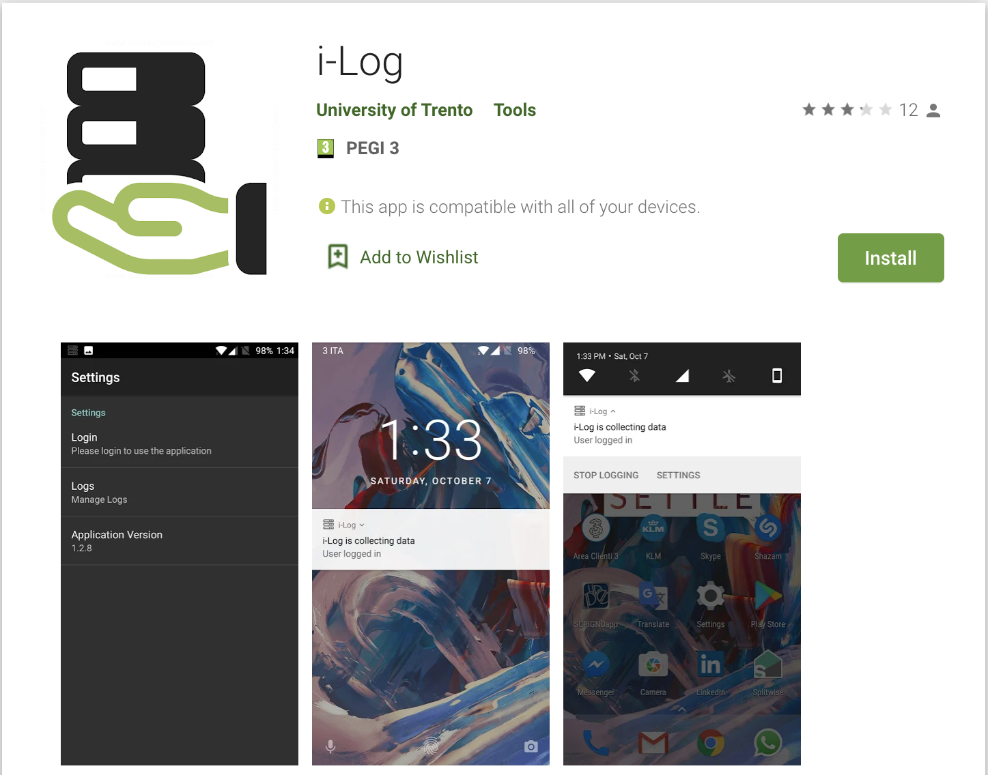
Requirements

Slide 27
PlayStore download

Slide 28
How the application works

Slide 29
Sensor data collection

Slide 30
Time diaries collection

Slide 31
Experiment setup

Slide 32
Experiment start

Slide 33
Experiment end

Slide 34
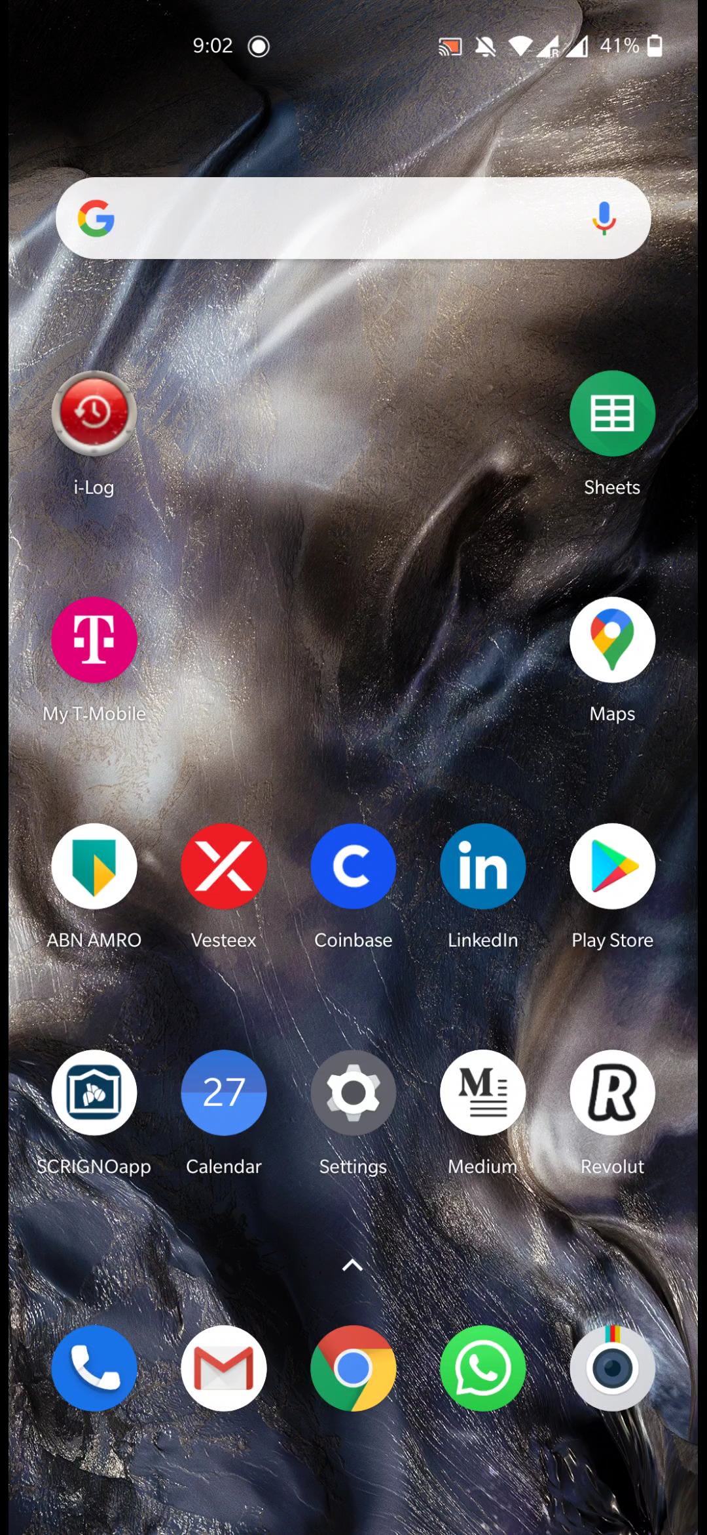
i-Log installation procedure
On the 12th of October (better if the day before) you have to install the i-Log application
After the installation you need to set it up for the project of the course
The project code is: 121020
The permissions’ granting procedure may be slightly different, depending on your smartphone’s model and operating system version
The most important aspect you should take care of is battery optimization

